Slide 1

TrashCan - Application to segregate Waste using Deep Learning
SRM INSTITUTE OF SCIENCE AND TECHNOLOGY
SCHOOL OF COMPUTING
DEPARTMENT OF COMPUTING TECHNOLOGIES
18CSP107L - MINOR PROJECT
Supervisor name: Dr. S. Babu
Designation: Associate Professor Department: Department Of Computing Technologies
Batch ID: B139
Student 1 Reg. No: RA1911003010090
Student 1 Name: Naman Jain
Student 2 Reg. No: RA1911003010108
Student 2 Name: Suvodeep Saibal Sinha

Slide 2
Project Abstract
In 2021, India currently ranks 155 out of 180 countries in the environmental performance index. This is due to poor handling of waste management and pollution. With the emergence of several government schemes such as “Swachh Bharat Abhiyan” and “Smart Cities Mission”, there has been a surge in both garbage production and its collection. But, there is zero effort to segregate the waste.
A major part of segregation is still dependent on manual labor which is slow and inefficient. Hence, we propose an automated way to segregate waste into recyclable and non-recyclable components using Deep Learning(Convolutional Neural Networks) embedded into a Mobile Application.

Slide 3
Problem Statement
Garbage Recycling is a key aspect of preserving our environment. To make the recycling process possible/easier, the garbage must be sorted into groups that have similar recycling processes.
We found that most available datasets classify garbage into a few classes (2 to 6 classes at most).
Being able to classify the images into more classes is a big step towards improving the recycling process by increasing the percentage of recycled garbage.

Slide 4
Objectives
Segregation and management of waste have been a longstanding issue that has impacted a vast percentage of the ecosystem. It is easier to manage waste using today’s technology if they are applied properly.
We found that most available datasets classify garbage into a few classes (2 to 6 classes at most). Despite that, among all the previously explored options, the highest accuracy achieved was 79.94% with CNN and (SVM as last layer) using partial data augmentation. However, no matter what techniques which were added on, it was extremely hard to break through the 80% threshold with the scratch model.

Slide 5
Proposed Methodology
We propose an automated way to segregate waste into recyclable and non-recyclable components using Deep Learning (CNN) embedded into a Mobile Application. We use image classification techniques on a dataset of 15000+ images consisting of different types of waste. The system will be tested on real images taken by the user within the intended usage environment through our mobile application. After processing the images, the application will correctly classify the waste as recyclable or not for the benefit of the user.
We plan to achieve this by using a diverse dataset and software tools like Tensorflow, Python, Flask, Android Studio, and Flutter.

Slide 6
Architecture Diagram

Slide 7
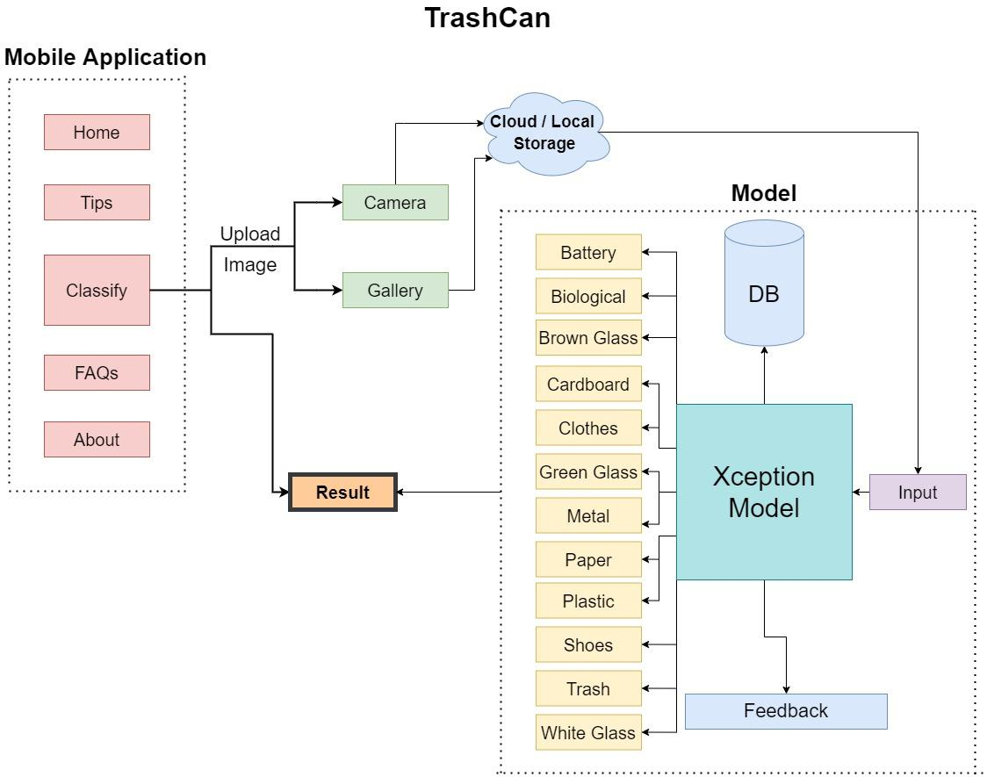

Slide 8
Flow Diagram

Slide 9
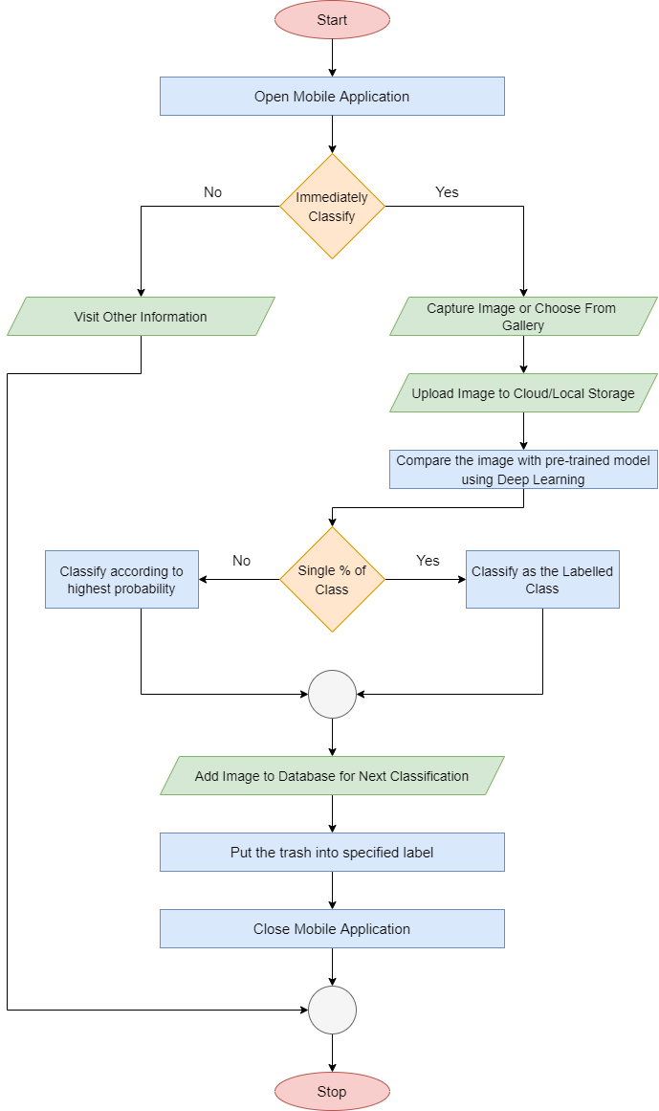

Slide 10
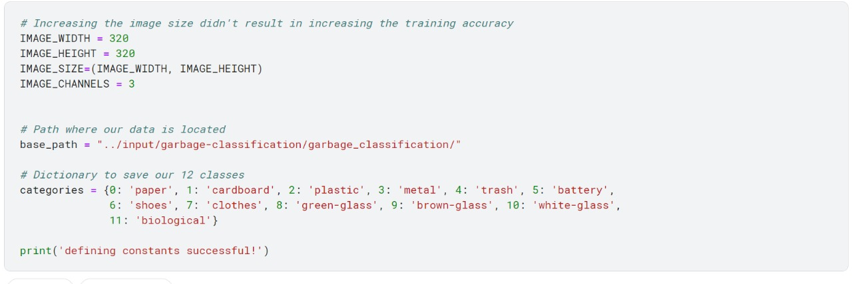
Module Description and Implementation
Defining Categories and Parameters

Slide 11
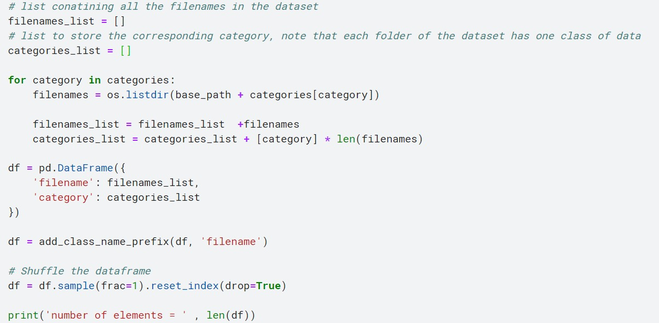
Cleaning Data

Slide 12
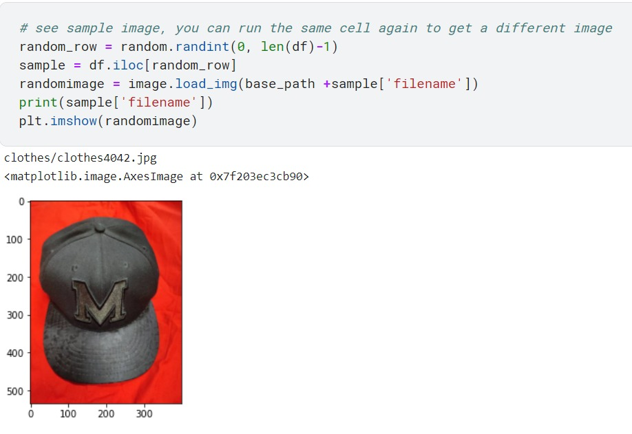
Visualizing Data

Slide 13
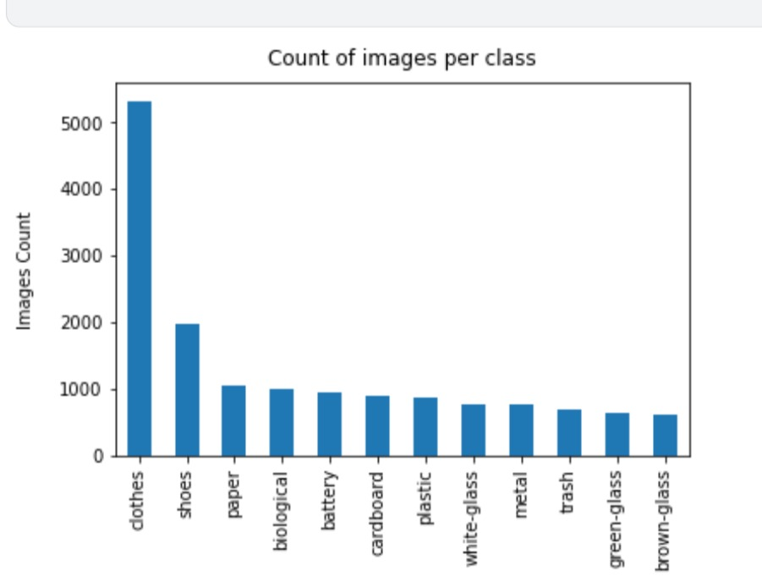
Intermediate Results
and Discussion
Category Distribution

Slide 14
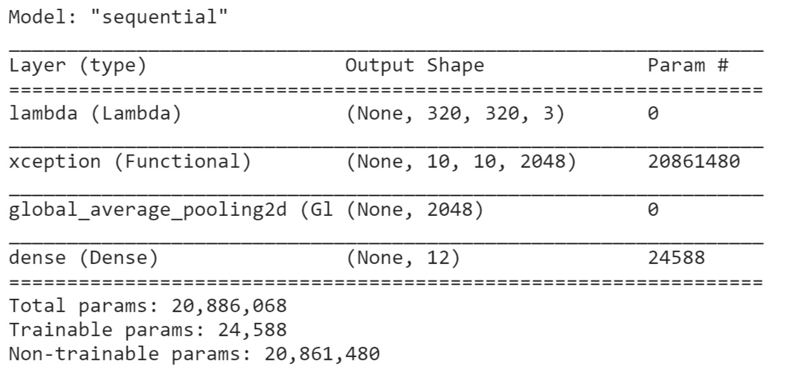
Model Structure

Slide 15
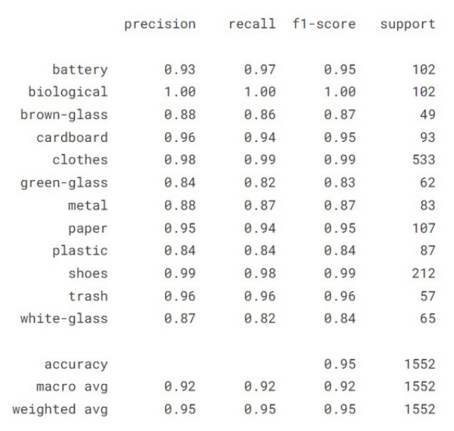
Accuracy Analysis

Slide 16
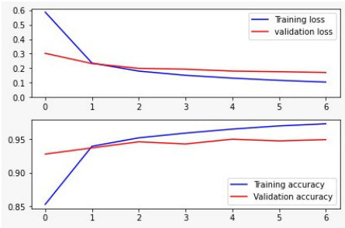
Accuracy Representation

Slide 17
Screenshots

Slide 18
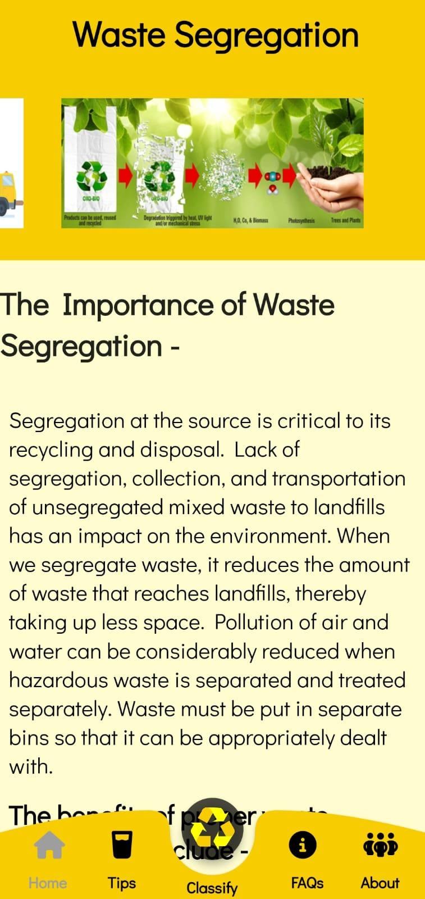
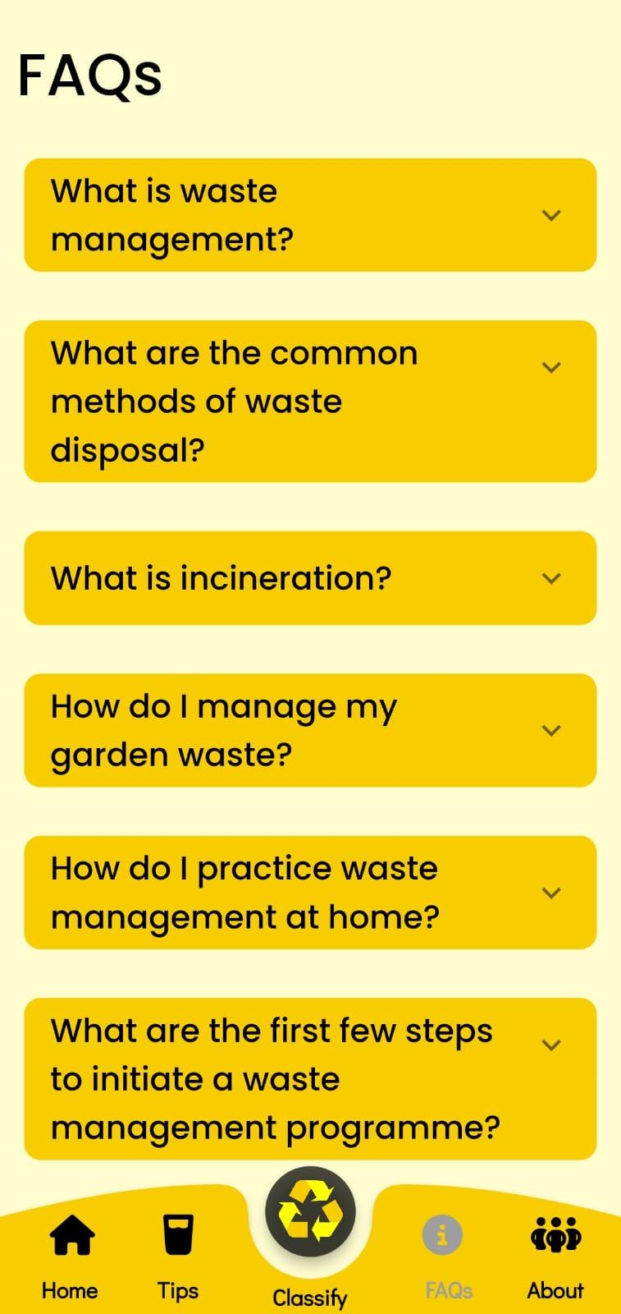

Slide 19
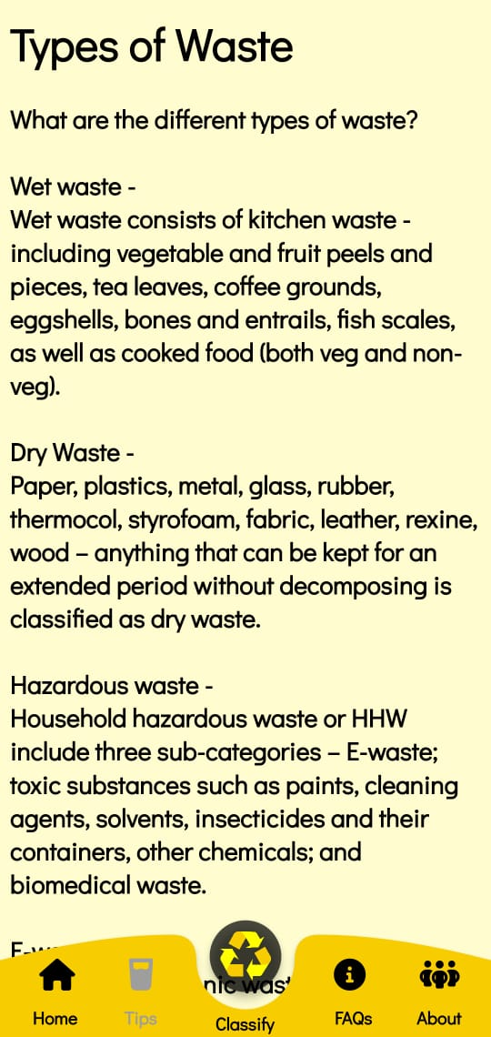
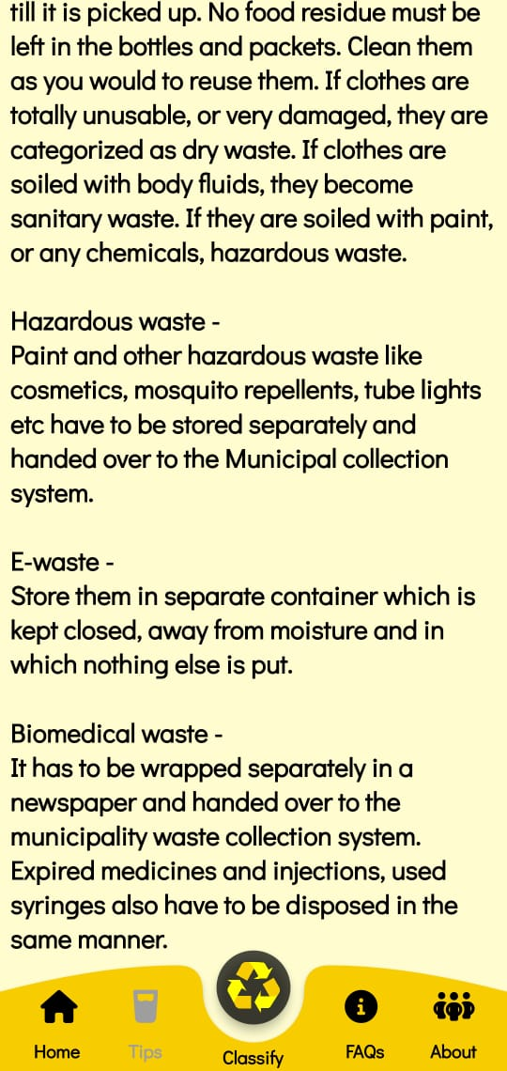

Slide 20
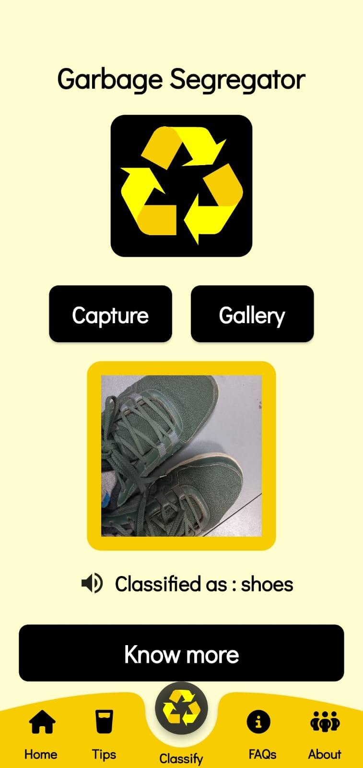
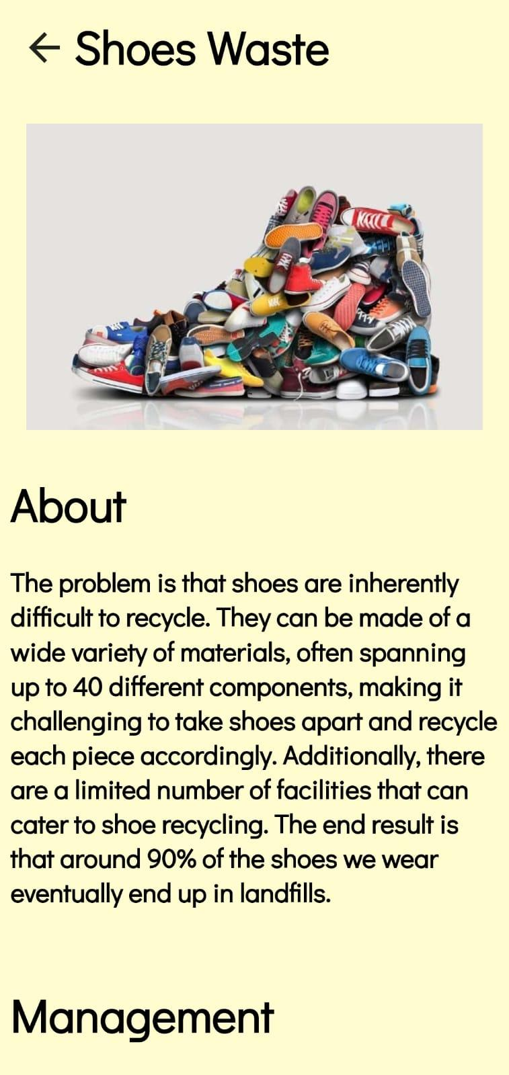

Slide 21
References
F. Chollet. Keras. https://github.com/fchollet/keras, 2015. [3] D.-A. Clevert, T. Unterthiner, and S. Hochreiter. Fast and accurate deep network learning by exponential linear units (elus). arXiv preprint arXiv:1511.07289, 2015.
https://link.springer.com/content/pdf/10.1007/s40747-021-00529-0.pdf
. Chu Y, Huang C, Xie X, Tan B, Kamal S, Xiong X (2018) Multilayer hybrid deep-learning method for waste classification and recycling. Comput Intell Neurosci
Github | “Trashnet waste repository”. https://github.com/ garythung/trashnet.
Sekar S. Waste classification data. Kaggle, 16 June 2019, www. kaggle.com/techsash/waste-classification-data.
Serezhkin A. Drinking waste classification. Kaggle, 10 May, 2020, www.kaggle.com/arkadiyhacks/drinking-waste-classification

Slide 22
ANY QUESTIONS

Slide 23
THANK YOU

